Slide 1

Spotify: Using Data Analytics to Solve Real World Problems
Shane Artis, Luke Faro, Elijah Eberly, Larry Agyei

Slide 2

Introduction of Spotify
A digital music, podcast, and video service that gives you access to millions of songs and other content from creators all over the world
A proprietary Swedish audio streaming and media services provider founded on 23 April 2006 by Daniel Ek and Martin Lorentzon
One of the largest music streaming service providers, with over 489 million monthly active users, including 205 million paying subscribers

Slide 3

Introduction of Spotify
Offers a paid subscription called spotify premium
Download music to listen anywhere
Ad- free music listening
Allowed to play any song
Unlimited skips
Cost: $9.99 per month
Offers a free version which contains ads but allow you to listen to music and podcasts without expense

Slide 4

The Problem
Spotify serves 406 million active users across 184 markets, along with millions of creators that have generated 82 million music tracks and 3.6 million podcasts
This number increases by anywhere from 20k - 60k new pieces of audio daily
The challenge of making on-point recommendations and personalized experiences is a problem of scale.

Slide 5
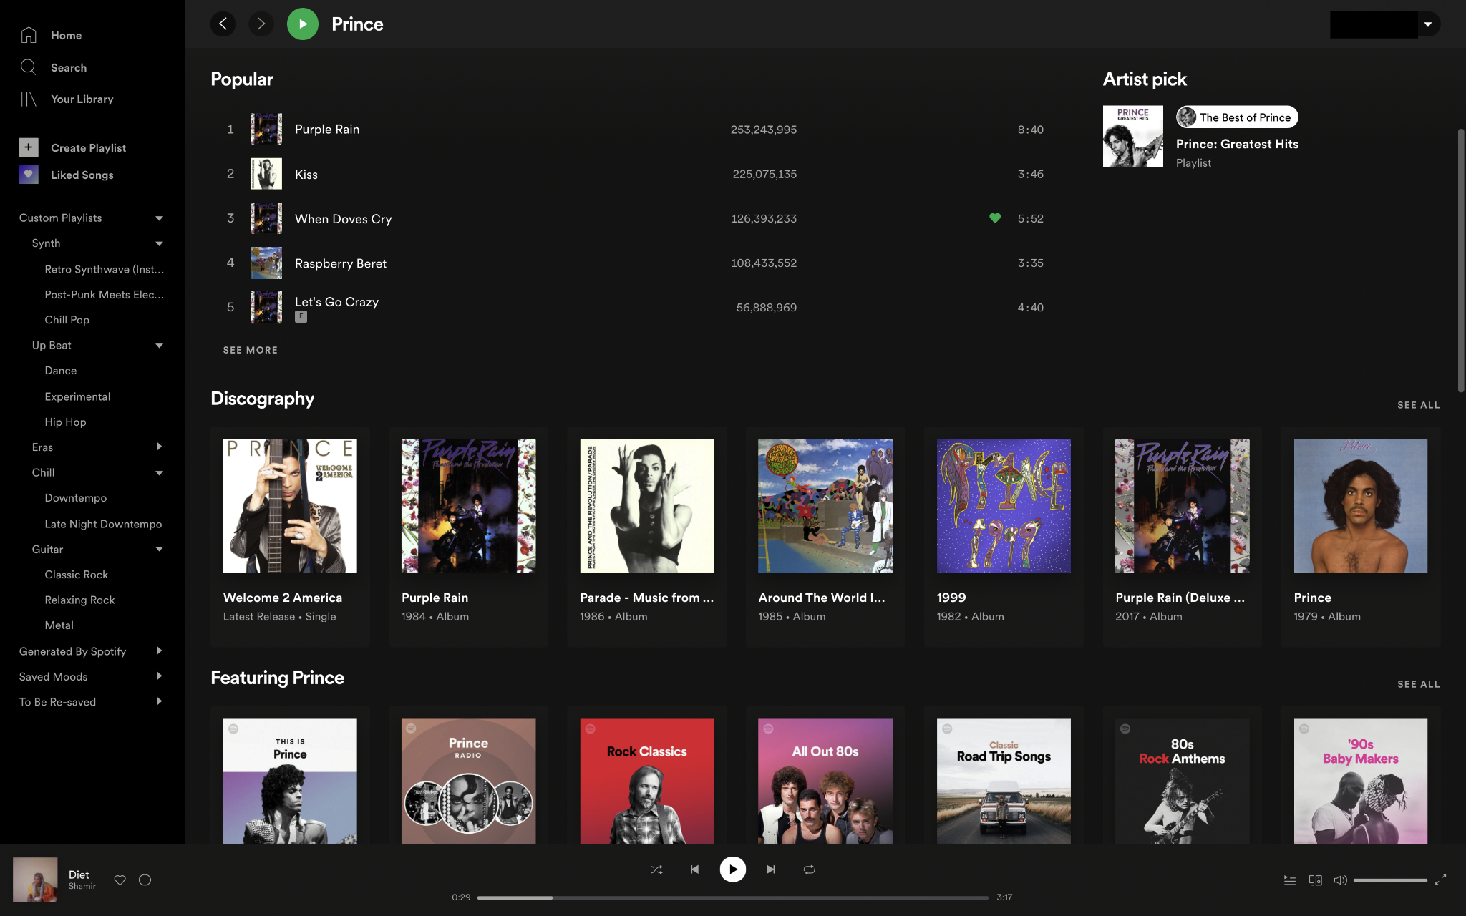
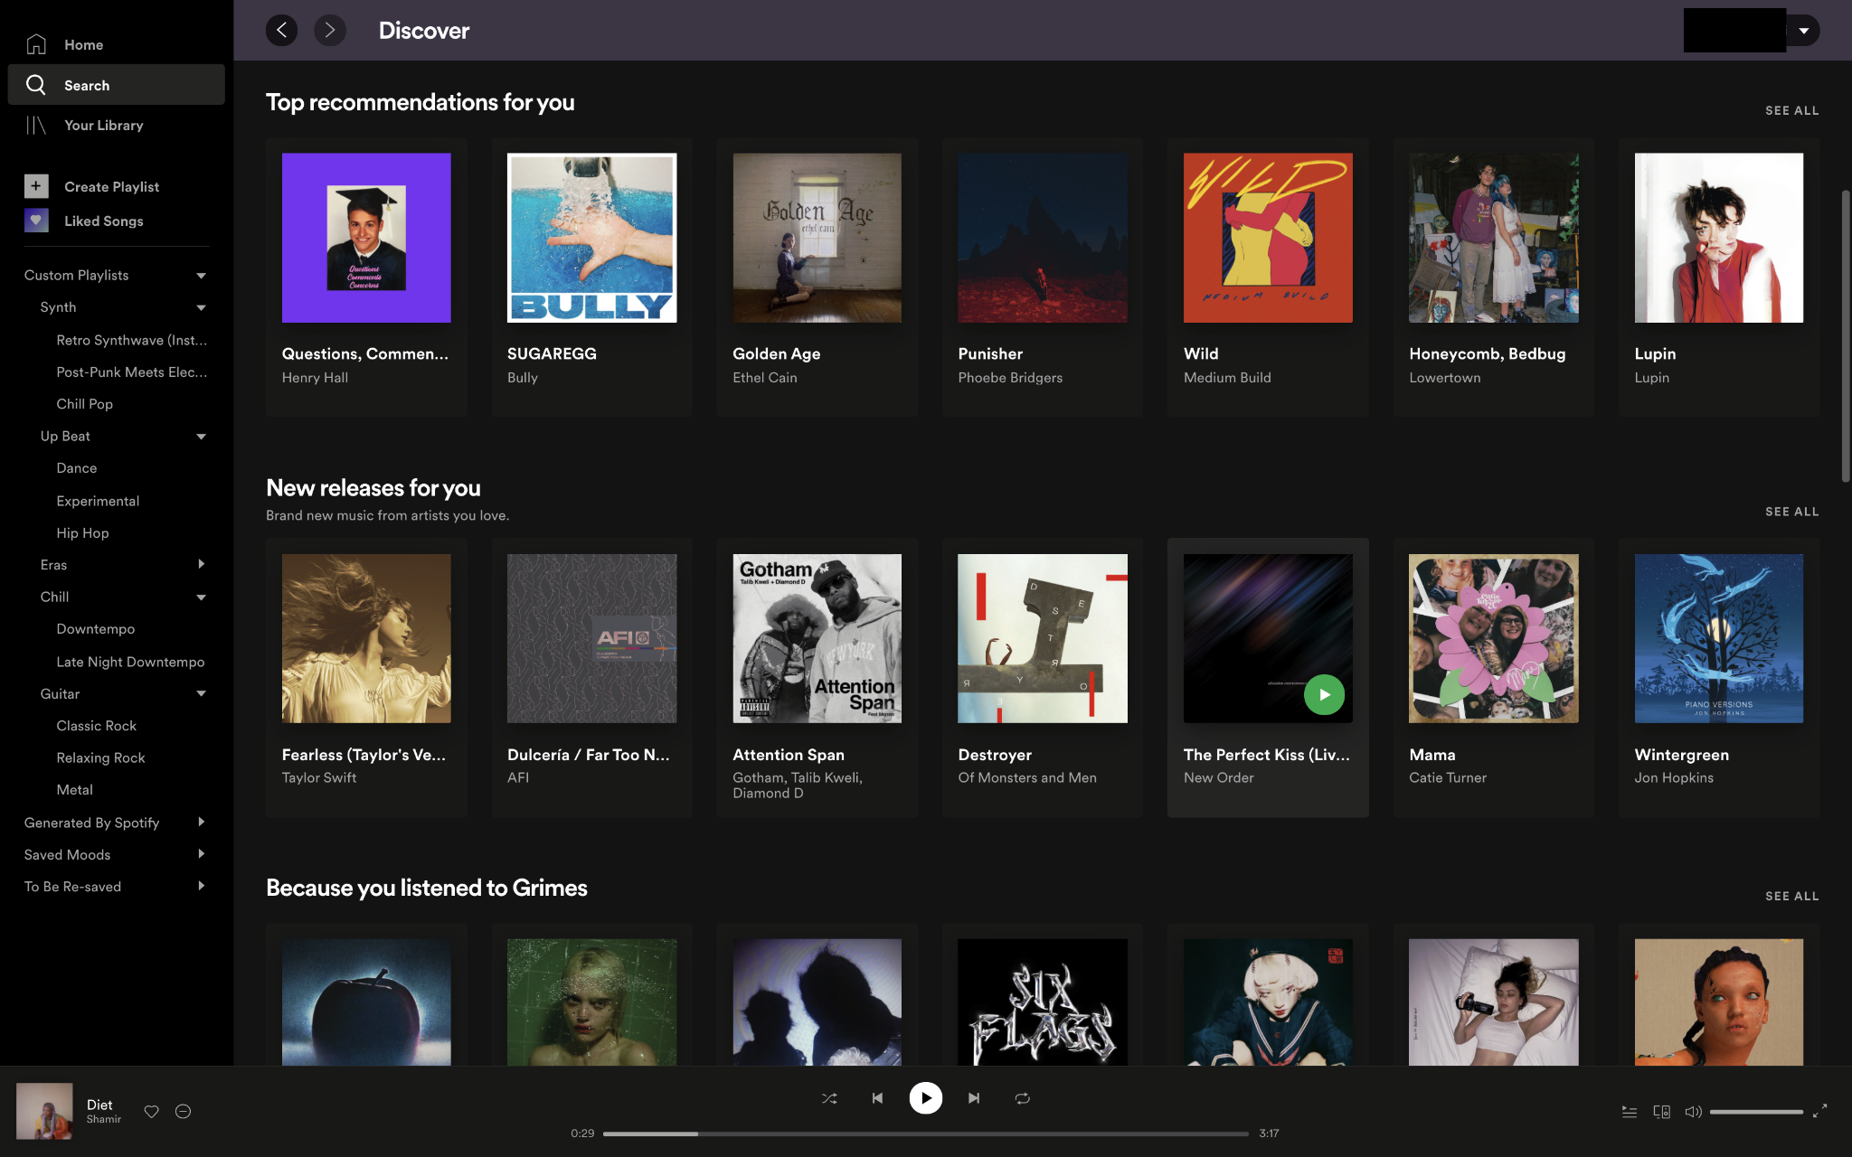
Variables Of The Problem
On one hand Spotify has hundreds of millions of content to show to its users, while on the other there are hundreds of millions of users interacting with the platform regularly
Finding and recommending one song out of hundreds of millions of them is a very hard thing to do
Giving accurate suggestions solves a customer’s problem of finding music that they enjoy without them having to listen to millions of songs

Slide 6

Variables Cont’d
For Spotify to have a sustainable business model and lifelong customer retention
The app needs to be able to have a regular flow of new recommendations for its users
One way the app does this is by encouraging users to use its exploration features to enjoy new experiences
Spotify’s algorithm also tries to bring users more of the familiar content they are used to at the same time
“If you let search decide what people listen to, they don’t diversify as much,” “You have to recommend and nudge users into new things.”
- Tony Jebara, Head of machine learning at Spotify

Slide 7
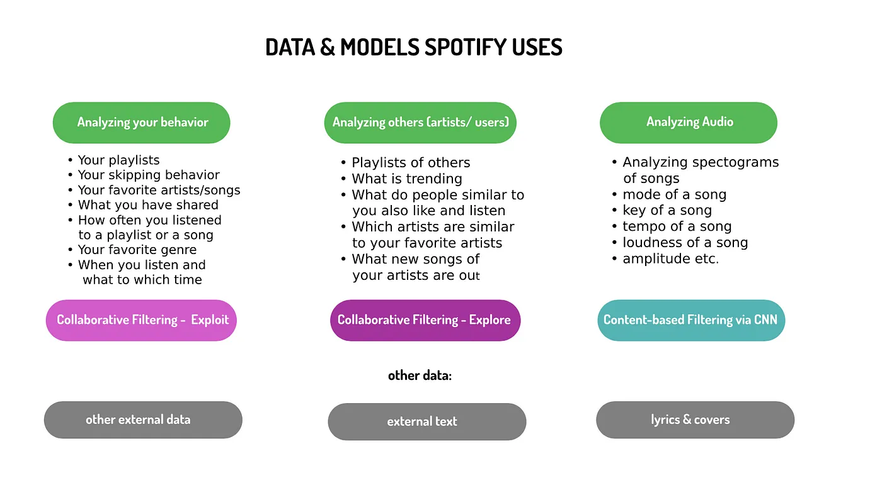
Data Collection
Internal Data:
Artist Data : Song Name, Description, Genre, Images, Lyrics, and Song Files
Consumer Data: Listening History, Skipped Songs, Song Frequency, Playlist Stored, Music Downloaded, and Social Interactions
External Data:
Articles, Blog Posts, and Other Text Data About Songs/Artists
3 Musical Intelligence
Echonest (Over 1 Billard of Data)
Seed Scientific (Data Analysis and Analytics Consultancy)
Sonalytic (Audio Detection Startup)
This data is then used to train models to learn what the users tastes are

Slide 8
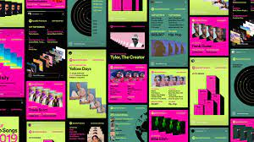
Data Collection Cont’d
Spotify has general user reaction classifications that are used to determine how well a song fits a user’s tastes
These reactions are used in conjunction with the user’s “taste profile” (qualities of music/genres that Spotify’s AI assigns as being favored by a user) to find new songs to recommend
A song being skipped shortly after starting logs a negative response
A song playing to completion logs a positive response
“We think that personalization should deliver a lifetime of content rather than optimize for the next click”- Tony Jebara Head of Machine learning at Spotify

Slide 9
Analysis
By collecting user data, Spotify can personalize the user experience. For example on the app, the user’s homepage, search page, and suggested playlist can be customized.
One of the platform’s most successful tools is its Discover Weekly, which uses the previously mentioned data to recommend songs that the user specifically has not listened to before.
In a similar vein, Spotify Wrapped collects a user’s favorite songs and compares their listening stats for an artists to others who also play the artist’s music
Another feature that Spotify has been working on is called a blended playlists, where users are able to blend their music taste with a friend’s or with similar artist.

Slide 10
Analysis Cont’d
Spotify’s usage of user data extends beyond recommending them new songs to play
By utilizing user data in conjunction with other information available to the platform, spotify has been able to create highly successful ads, such as the Williamsburg Beiber ad that ran in the New York neighbourhood.
Spotify uses the data it collects to expand the services it provides; Spotify for Artists is a separate application that lets creators on the platform view various statistics involving their work, such as which albums attract new listeners for them, or where their listeners are located.

Slide 11
Implementation
Originally Spotify had used machine learning techniques called collaborative filtering
Spotify has changed its method due to the sophistication of human editorial knowledge.
It now has algotorial playlists, where lists are created by human editors and customized by algorithms
“It turns out, you can’t do everything in the world with just machine learning,” Jebara said. “We also rely a lot on our editors because they have trillions of real neurons between their ears, and are cutting-edge cultural experts that can tell us there’s a new genre of music coming up.”

Slide 12
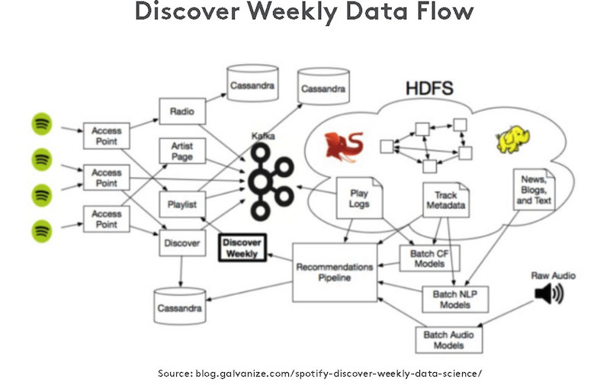
Implementation Cont’d
Use of Recommender System
Deliver suggestions based on behavior or characteristics that have been tracked by the system
3 Types of Recommender Systems
Collaborative Filtering - filters out items a user might like on the basis of reactions by similar users
Content Based - rely on available features (gender, age, ect.) to build a model
Hybrid - Combination of the two

Slide 13
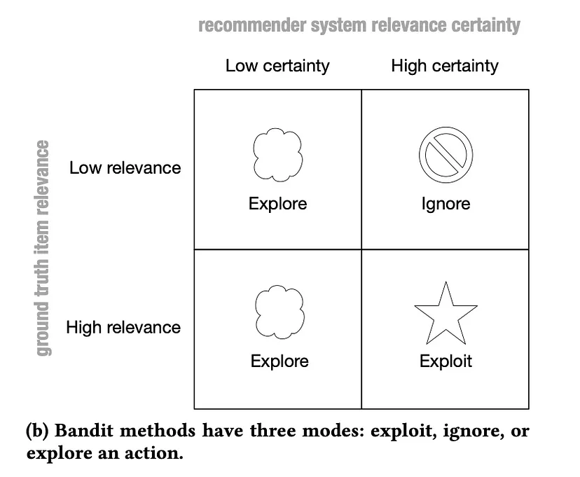
Implementation Cont’d
BaRT (Bandits for Recommendations and Treatment) Model
Exploitation Mode
Uses all data available about the user and items
Collaborative Filtering is used
Item Relevance
Exploration Mode
Recommends content with uncertain user predicted user engagement
Positive recommendation if played 30 seconds or longer
Based on reinforcement learning derived from classical Bayesian probability
Multi-Armed Bandit
Trained to execute a certain action for which the probability is the highest to receive a reward
Every action is based on previous actions and rewards
Maximize total sum of rewards

Slide 14
Results
Spotify’s goals involving what machine learning can do are encourage Spotify listeners to try new music and podcasts
Jebra has stated that “reinforcement learning is already giving us huge wins over machine learning”
The goal is to hopefully have a lifetime of content rather than optimize for the next click
The end result is that Spotify remains the No. 1 streaming audio service with a sizable lead over Apple, Amazon and YouTube Music in reported paid subscribers. Thanks to the help of its personalization algorithms creating a personalized service and experience to the consumer

Slide 15

Questions?

Slide 16
Sources
https://mitsloan.mit.edu/ideas-made-to-matter/how-wayfair-and-spotify-use-machine-learning-to-engage-customers
https://www.cnbc.com/2022/11/10/how-spotify-stayed-no-1-in-streaming-music-vs-apple-youtube-amazon.html#:~:text=Spotify%20stayed%20No.-,1%20in%20streaming%20audio%20even%20with%20Apple,and%20Amazon%20aiming%20for%20it&text=Spotify%20remains%20the%20No.,nearly%20200%20million%20paying%20customers.
https://towardsdatascience.com/uncovering-how-the-spotify-algorithm-works-4d3c021ebc0
http://rstudio-pubs-static.s3.amazonaws.com/329551_2847e778053e4b17a017f949d2dd5b91.html
https://towardsdatascience.com/uncovering-how-the-spotify-algorithm-works-4d3c021ebc0

